Slide 1

Welcome to our
MATHEMATICS
Class
Prepared by: Mr. Fajardo

Slide 2
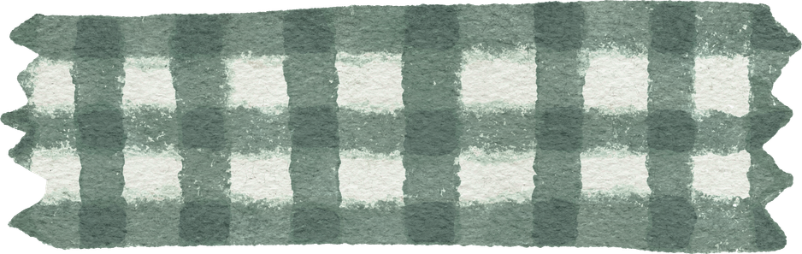
Learning Objectives
Recall the concepts and procedures related to quadratic equations.
Apply appropriate strategies in solving different types of quadratic equations.
Evaluate their readiness for the Mastery Test by identifying their strengths and areas for improvement.

Slide 3
Quadratic equations

Slide 4
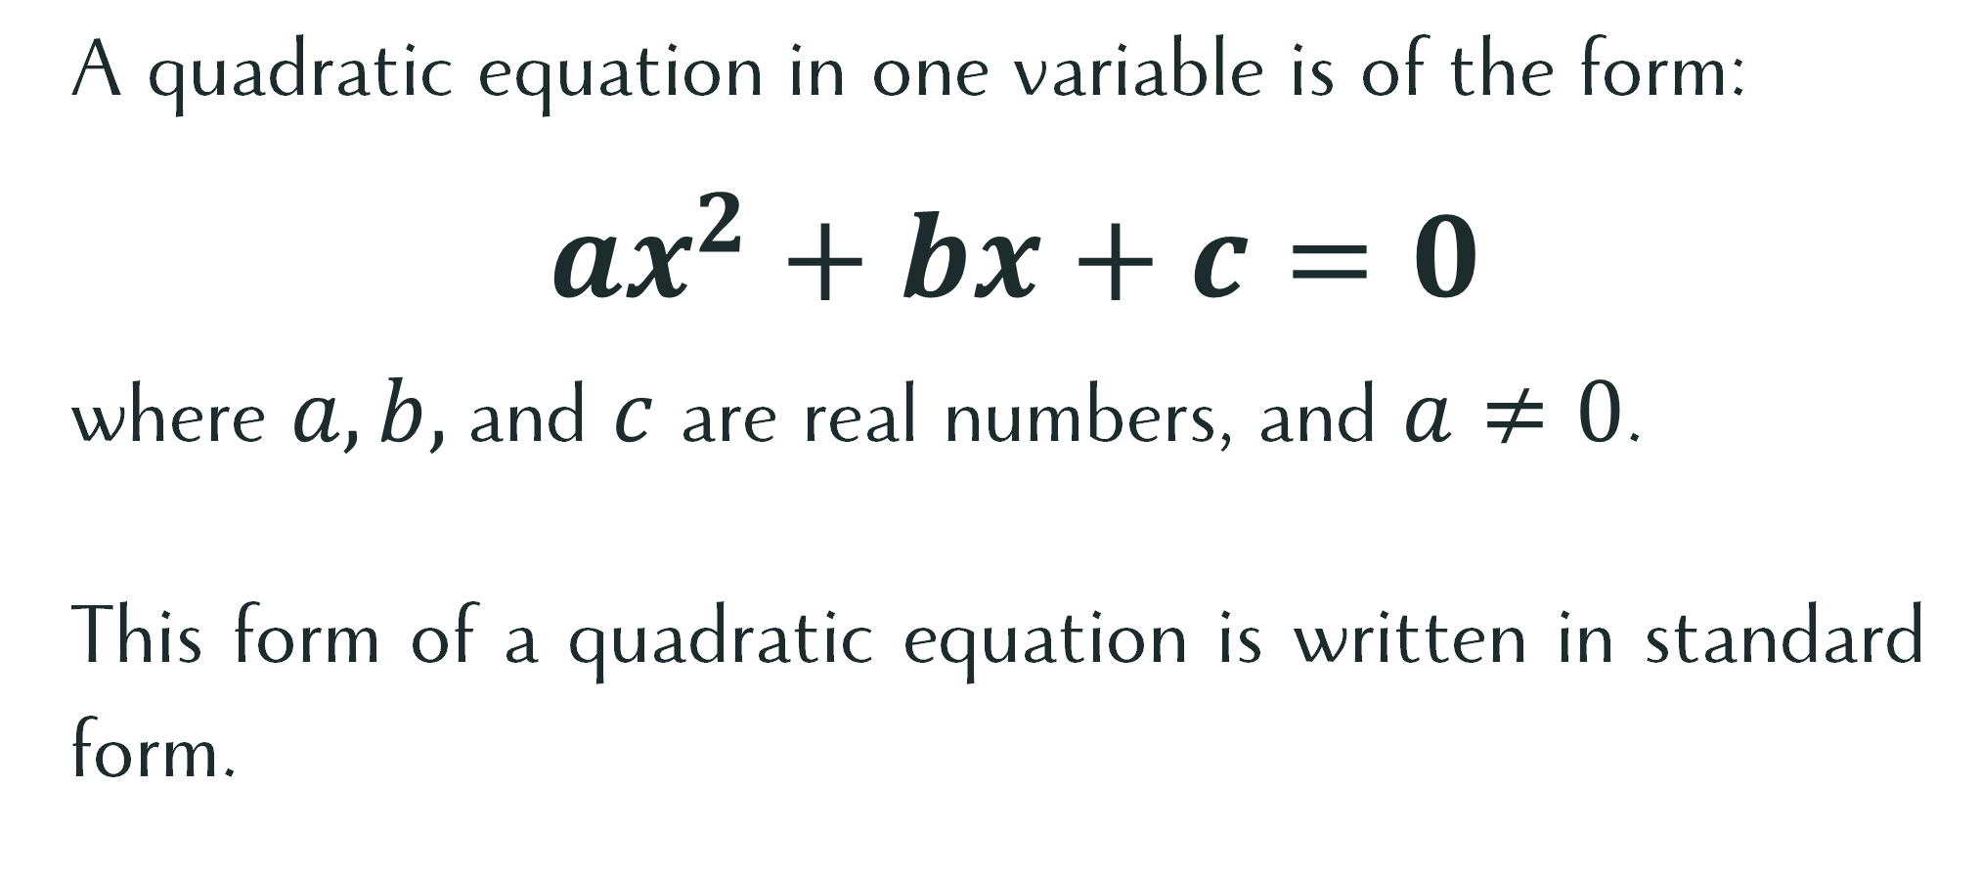
What is a Quadratic Equation?
A quadratic equation in one variable is of the form:
$ax^{2}+bx+c=0$
where $a, b,$and $c$ are real numbers, and $a≠0$.
This form of a quadratic equation is written in standard form.

Slide 5
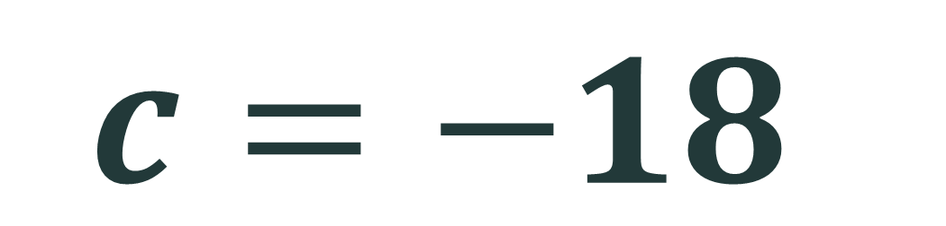


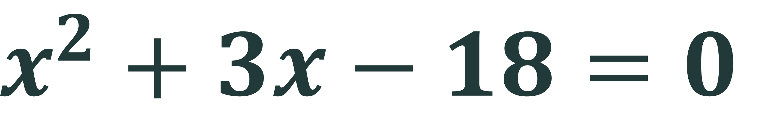
$$x^{2}+3x−18=0$$
$$a=1$$
$$b=3$$
$$c=−18$$

Slide 6
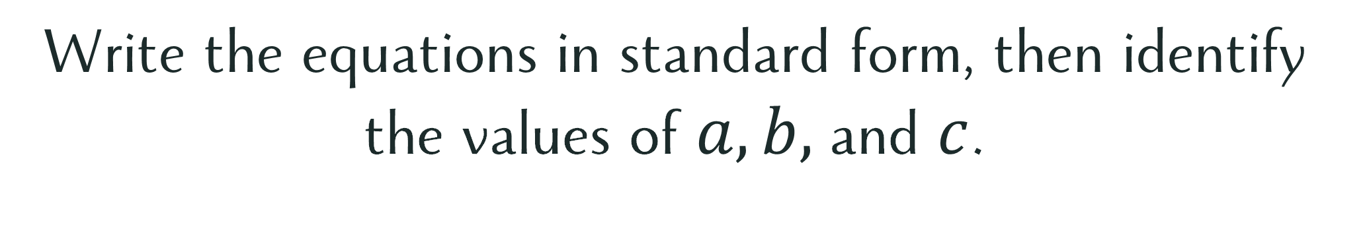


Let’s Try This!
Write the equations in standard form, then identify the values of $a, b,$and $c$.
Answers:
$3x^{2}+4x+4=0$
$2x^{2}+6x−3=0$
$a=3, b=4, c=4$
$a=2, b=6, c=−3$

Slide 7
Let’s recall!
Different Methods in Solving Quadratic Equations

Slide 8
Let’s Recall!
Extracting of Square Roots
Factoring
Completing the Square
Quadratic Formula

Slide 9
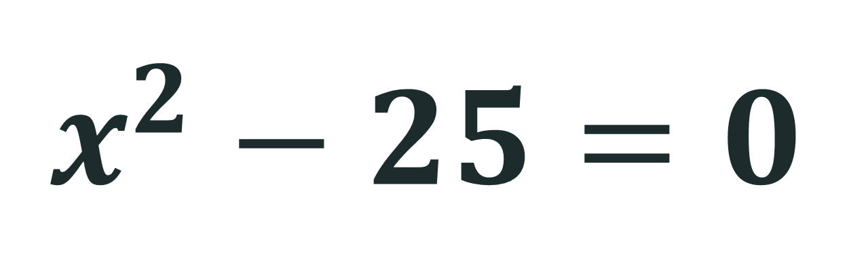
Extracting of Square Roots
$$x^{2}−25=0$$

Slide 10
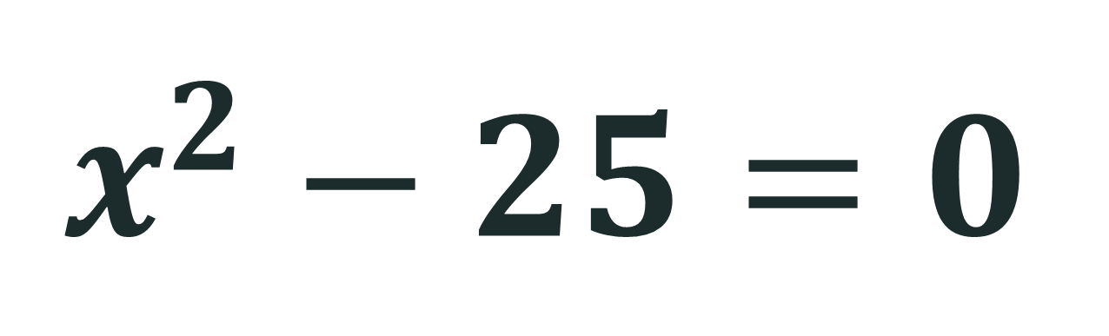

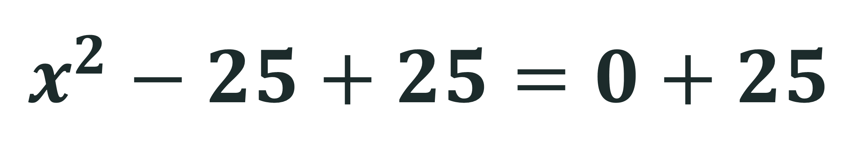
Extracting of Square Roots
$$x^{2}−25=0$$
$$x^{2}−25+25=0+25$$
$$x^{2}=25$$

Slide 11


Extracting of Square Roots
$$x^{2}−25=0$$
$$x^{2}=25$$
$$\sqrt{x^{2}}=±\sqrt{25}$$

Slide 12


Extracting of Square Roots
$$x^{2}−25=0$$
$$x^{2}=25$$
$$\sqrt{x^{2}}=±\sqrt{25}$$
$$x=±5$$

Slide 13
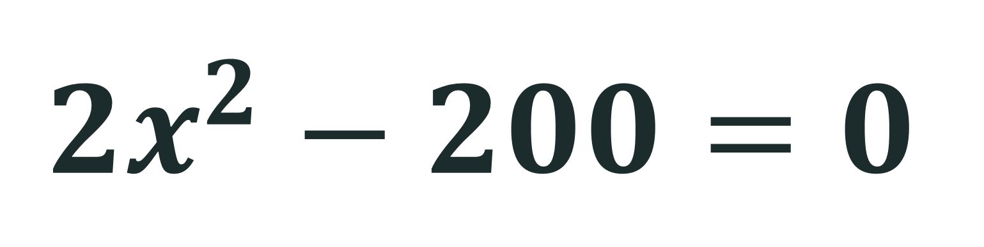
Try this!
$${2x}^{2}−200=0$$

Slide 14
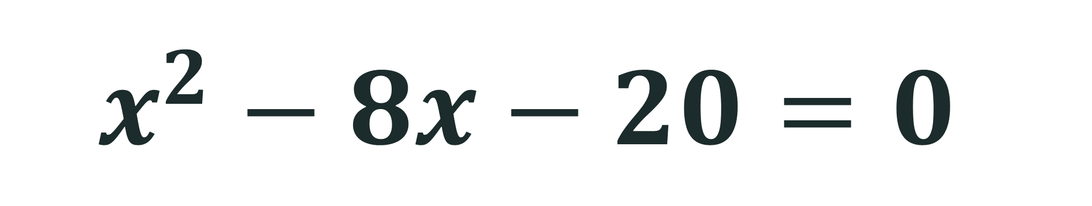

Factoring
$$x^{2}−8x−20=0$$
$$x=10, x=−2$$

Slide 15
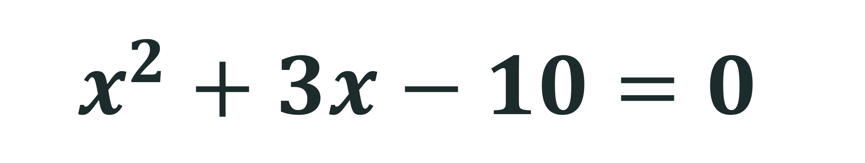

Try this!
$$x^{2}+3x−10=0$$
$$x=−5, x=2$$

Slide 16
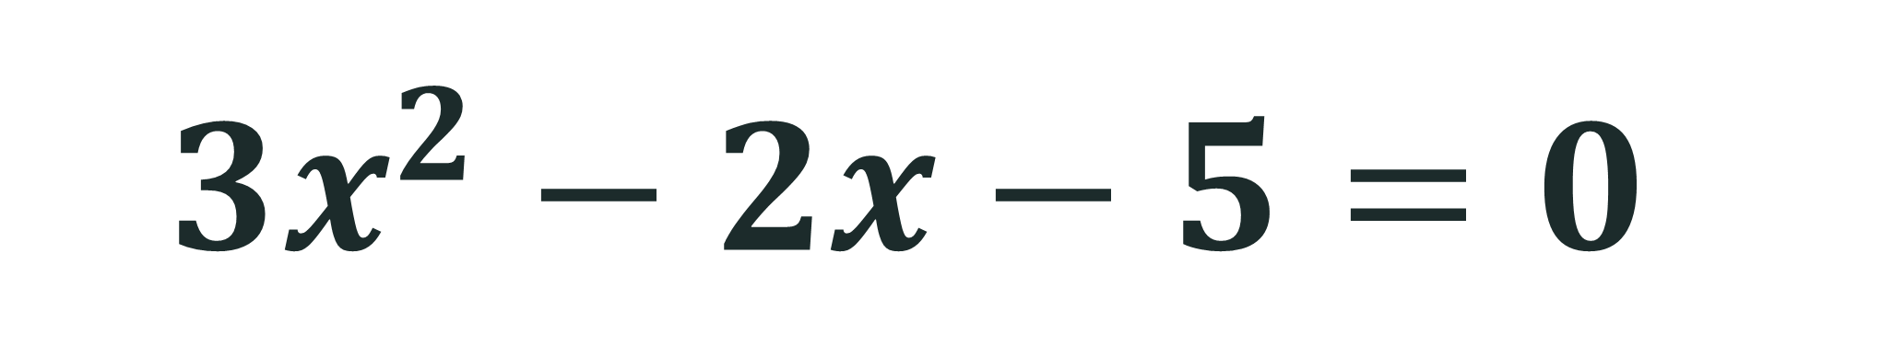
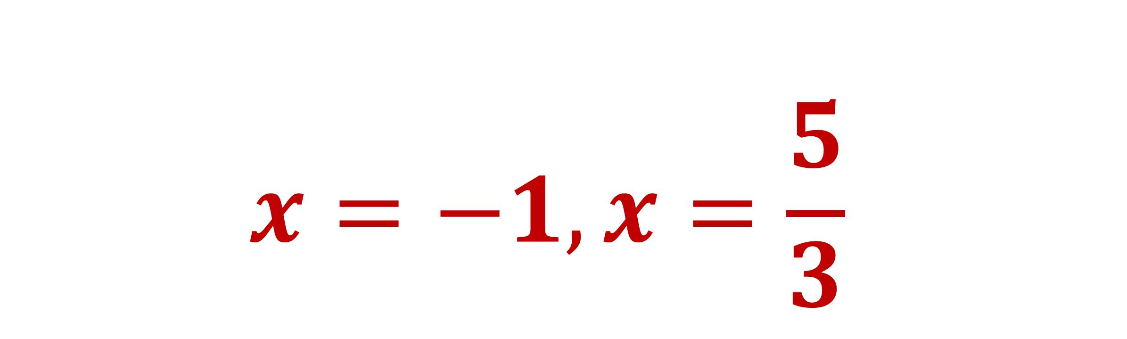
Factoring
$$3x^{2}−2x−5=0$$
$$x=−1, x=\frac{5}{3}$$

Slide 17
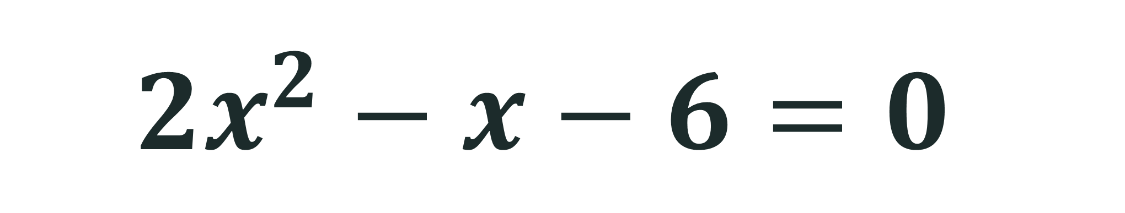
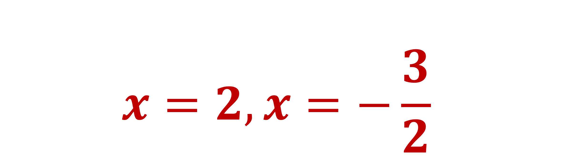
Try this!
$$2x^{2}−x−6=0$$
$$x=2, x=−\frac{3}{2}$$

Slide 18

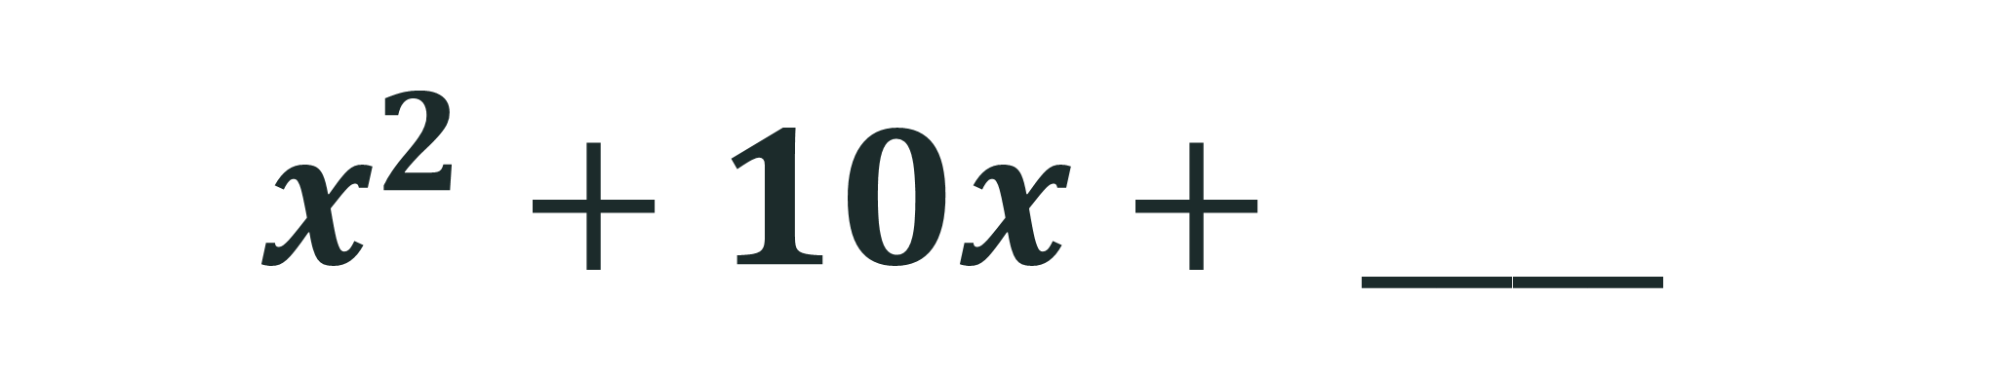
Completing the Square
$$25$$
$$x^{2}+10x+ ____$$

Slide 19

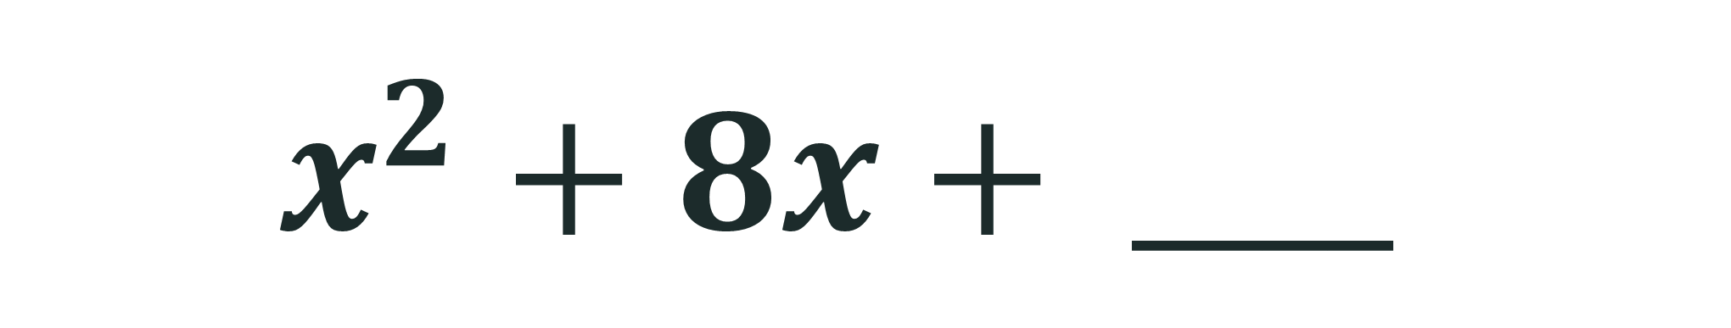
Completing the Square
$$16$$
$$x^{2}+8x+ ____$$

Slide 20
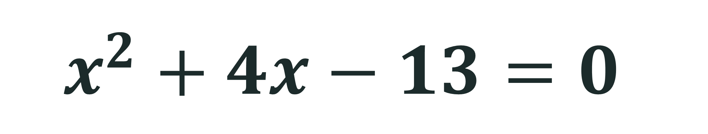
Completing the Square
$$x^{2}+4x−13=0$$

Slide 21

Quadratic Formula
$$x=\frac{−b±\sqrt{b^{2}−4ac}}{2a}$$

Slide 22
Quadratic Formula
$$x^{2}+4x−13=0$$

Slide 23
Let’s recall!
Sum and Product of Roots of a Quadratic Equation
Nature of Roots (Discriminant)

Slide 24
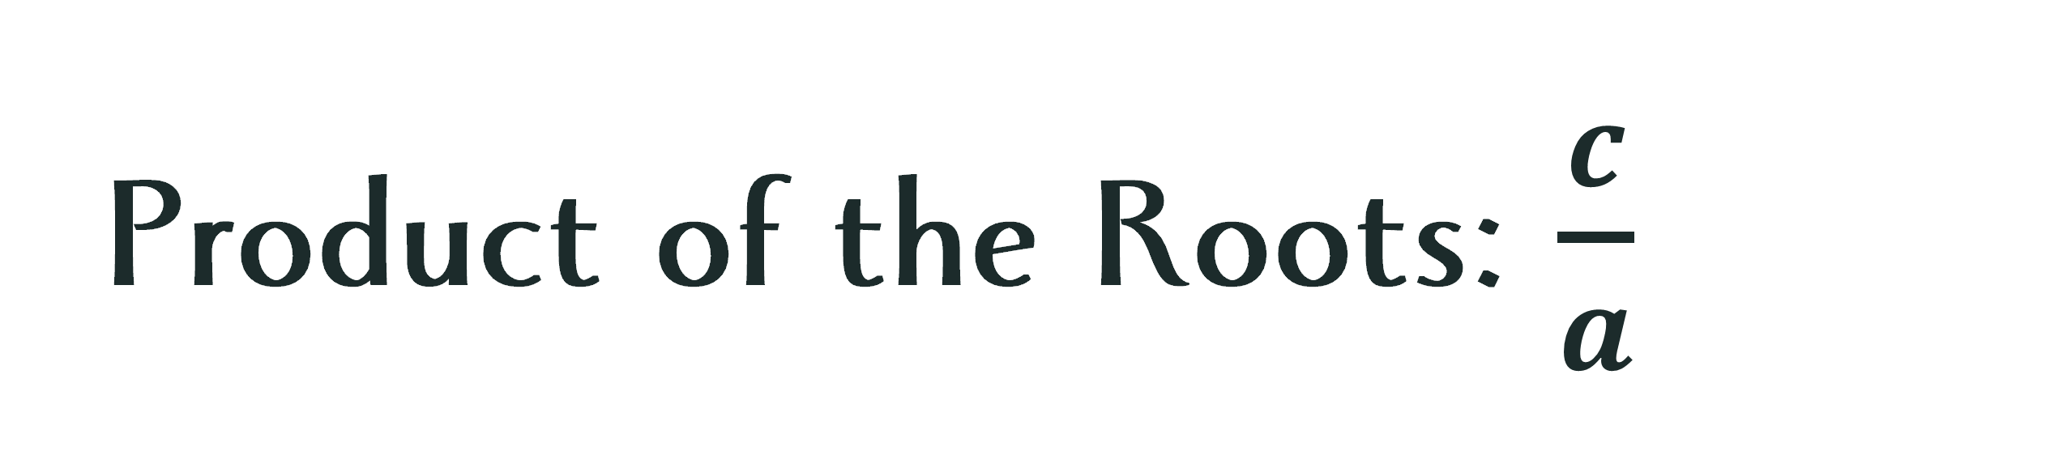
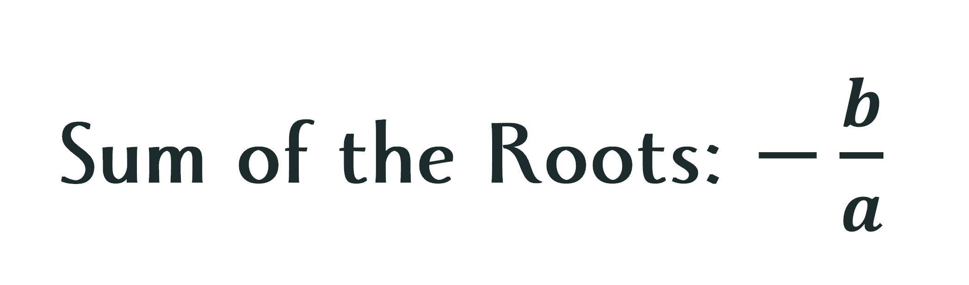
Quadratic Formula
Sum of the Roots: $−\frac{b}{a}$
Product of the Roots: $\frac{c}{a}$

Slide 25
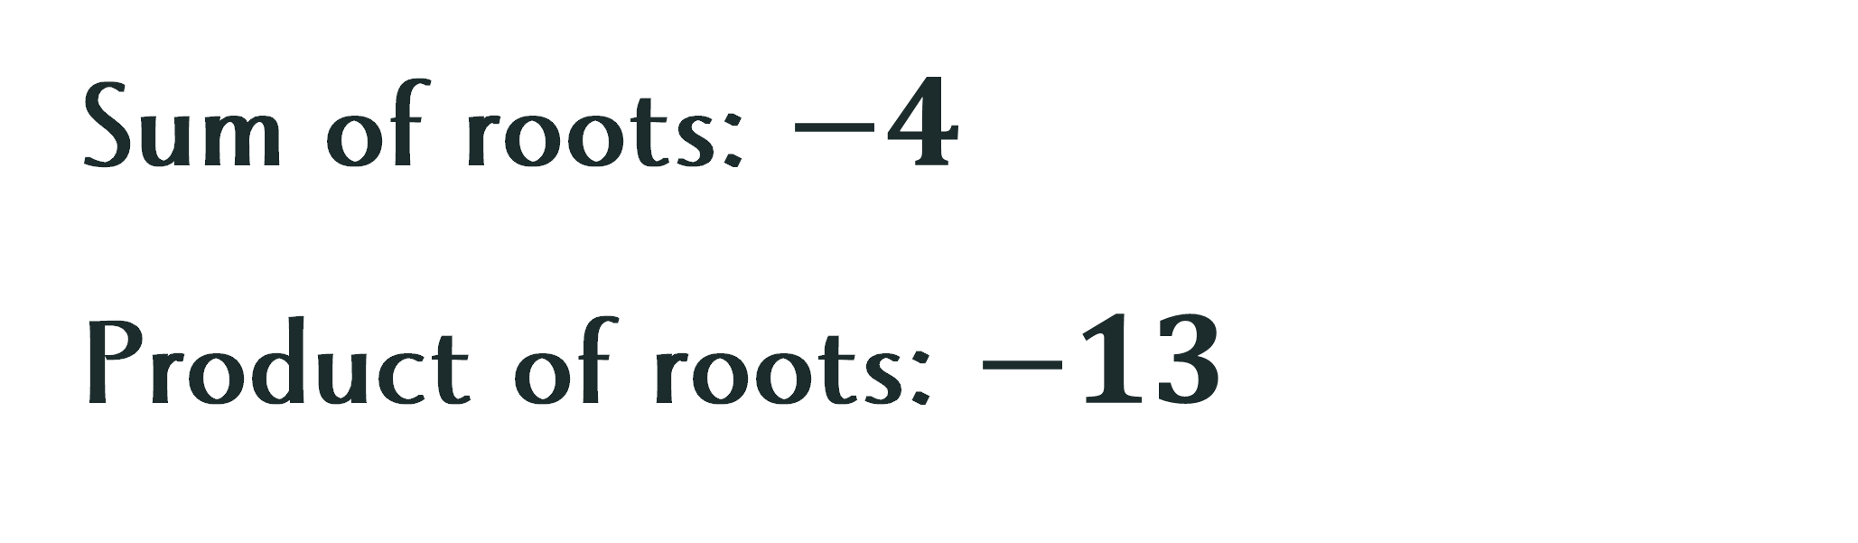
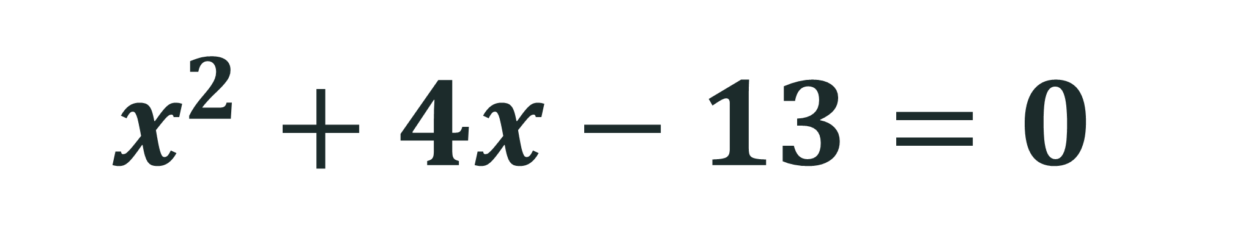
Sum and Product of Roots
$$x^{2}+4x−13=0$$
Sum of roots: $−4$
Product of roots: $−13$

Slide 26
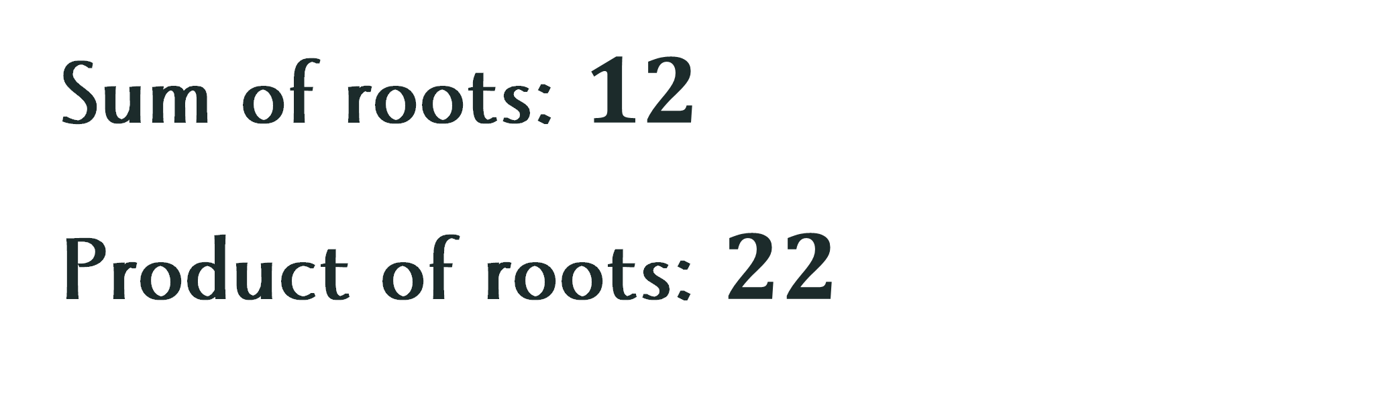
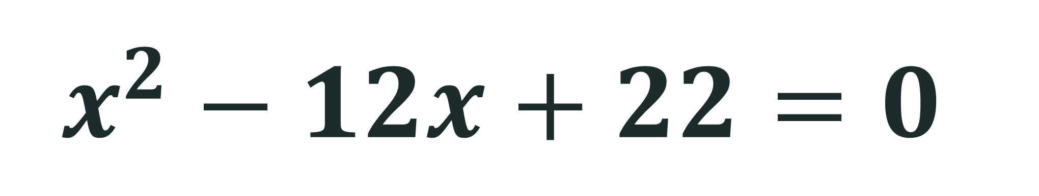
Try this!
$$x^{2}−12x+22=0$$
Sum of roots: $12$
Product of roots: $22$

Slide 27
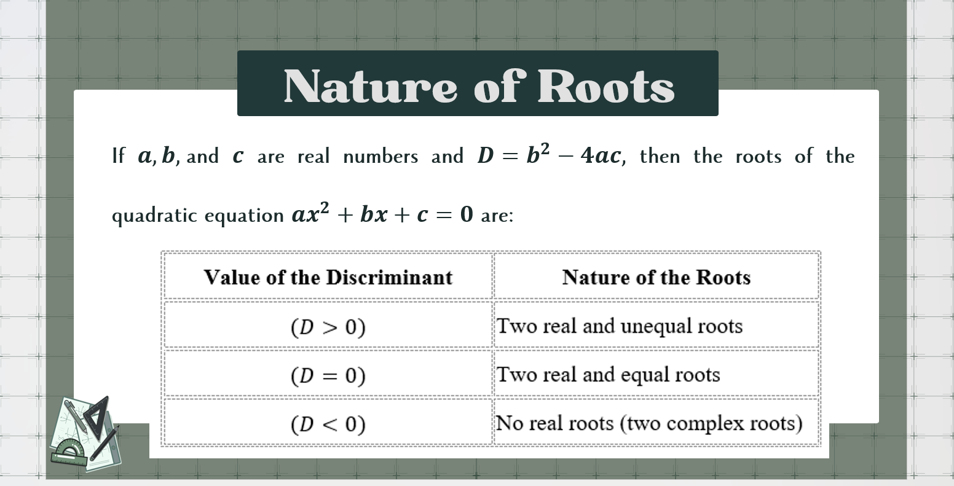

Slide 28
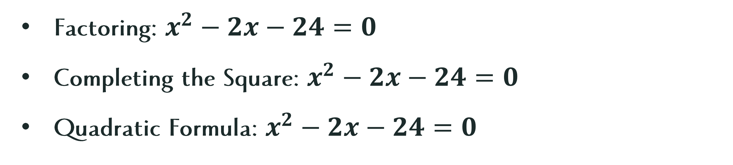
Solve the equation using the indicated method:
Extracting of Square Roots: $3x^{2}−12=0$
Factoring: $x^{2}−2x−24=0$
Completing the Square: $x^{2}−2x−24=0$
Quadratic Formula: $x^{2}−2x−24=0$

Slide 29
Let’s Reflect
The topic I feel most confident about is ______ because __________.
The topic I still need to improve is _________because _____________.
Before taking the Mastery Test, one thing I will do to prepare is_______________________.

Slide 30
Respect
Preparing for a test requires practice, patience, and the willingness to learn from mistakes. Why is it important to respect your own learning pace as well as the progress of your classmates?

